Slide 1


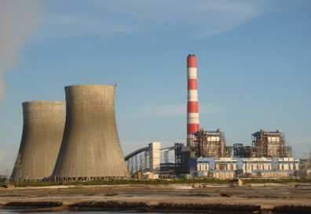
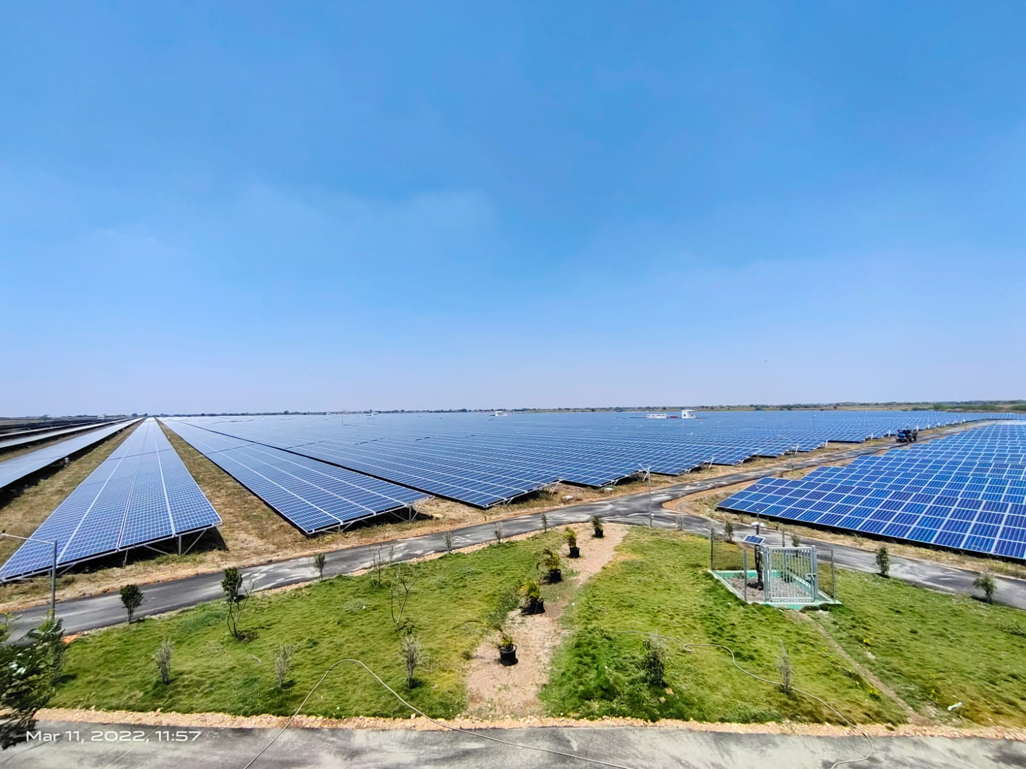
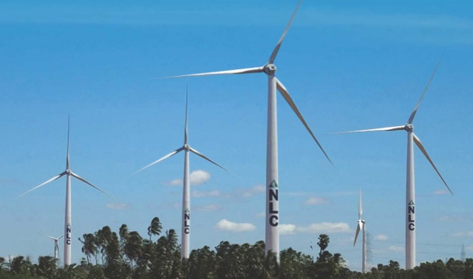
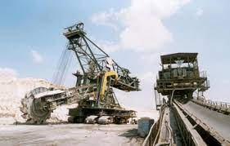
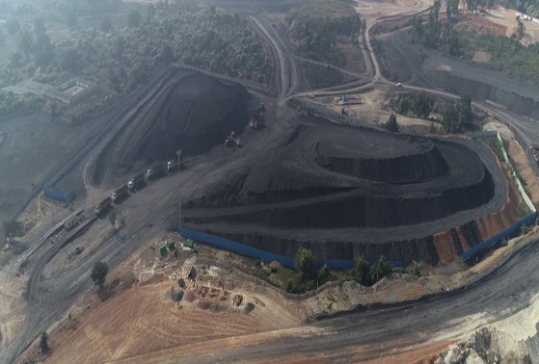

NLC INDIA LTD
Presentation on
CERC (Indian Electricity Grid Code) (First Amendment) Regulations, 2024 - DRAFT
CERC Public hearing on 14th AUGUST 2024

Slide 2
Comment – 1 (Minimum Turndown Level Protection)
Addition of new sub-clause (a)(v-a) after sub-clause (a)(v) of Clause (2) of Regulation 49 of the Principal Regulations:
In case a regional entity generating station, whose tariff is determined under Section 62 of the Act, gets a schedule below minimum turndown level for Off-Peak hours of the day, however, gets a schedule above minimum turndown level for Peak hours of the day, the schedule below the minimum turndown level may, on the request by such generating station to NLDC shall be adjusted under SCED
NLCIL’s Comment:
Instead of SCED, SCUC may be used to assure Minimum Turndown level in the above case.
Security Constrained Economic Despatch (SCED) : Optimised despatch of generating units subject to operational and technical limits of generation and transmission facilities. It is based on willingness of Generators under Section 62.
Security Constrained Unit Commitment (SCUC) : Committing generating units while respecting limitations of the transmission system and unit operating characteristics. It is compulsory for Generators under Section 62.

Slide 3
Detailed Justification for Comment – 1
Through Actual Schedule Trend for NLCIL’s two Thermal Stations on 11.08.2024
TPS1EXPN
(ECR: 2.84 Rs/unit & MTL: 248MW)
NTPL
(ECR: 4.16 Rs/unit & MTL: 521MW)
To keep higher cost units on bar to meet peak demand, SCUC UP schedule was given to those high cost units & SCUC down Schedule was given during 1PM to 7PM to comparatively low cost stations like TPS1EXPN & NTPL.
On the same day, for same NTPL MTL is not protected during 1PM to 4PM when its own schedule was < MTL.
As SCUC is more about keeping units on bar by assuring MTL schedule and SCED is more about Economic Despatch of Power, So SCUC may be used instead of SCED in the proposed Amendment.

Slide 4
Comment – 2 (Obligations in case of Unit Shut Down (USD)
As proposed in the Draft Regulation,
the schedule below the Minimum Turndown Level (MTL) will be adjusted up to MTL only if a Generator gets schedule from Beneficiaries above MTL during Peak Hours.
NLCIL’s Comment:
If the aforementioned condition is not met and the generator does not receive a feasible schedule throughout the day, then the generator will have two options:
  Opt 1:The generator may opt to undergo USD and revise its DC to zero.
In this scenario, there won’t be any obligation for Generator but despite being ready to dispatch the power, the generator would incur losses in fixed costs, resulting in under-recovery of investment on the project, irrespective of having a Power Purchase Agreement (PPA).
  Opt 2: Alternatively, the generator may choose to undergo USD without revising its DC.
As per the CERC IEGC Regulation 2023 (Principal Regulation), the generator is obligated to fulfil its obligations during hours where the schedule is available by procuring power from another source or market. This arrangement may lead to financial losses for the generator.
Therefore, it is humbly submitted that if ensuring the maintenance of the Minimum Turn-Down Level (MTL) schedule by all beneficiaries throughout the day is not mandated, then the obligation for the generator to supply power during USD may not be enforced.

Slide 5

Thank You
NLC INDIA LIMITED

