Slide 1
Views of GRIDCO on Draft CERC (Sharing of Inter-State Transmission Charges and Losses) (Fourth Amendment) Regulations, 2024
GRIDCO LIMITED

Slide 2
4. Amendment to Regulation 13 of the Principal Regulations
A. Proposed in the Draft:
(3) New sub-clauses (a-i) and (a-ii) shall be inserted after sub-clause (a) in Clause (2) of Regulation 13 of the Principal Regulations: “(a-i) Hydro PSP ESS, which has awarded the contract on or before 30.6.2025, shall be eligible for a waiver of transmission charges for a period of 25 years from the COD, subject to conditions as per sub-clause (c) of this Clause.
(f) Waiver for REGS or RHGS based on wind or solar source XXXXXXXXor Hydro PSP ESS which has awarded the construction contract after 30.6.2025 shall be eligible for grant of waiver in the following manner:

Slide 3
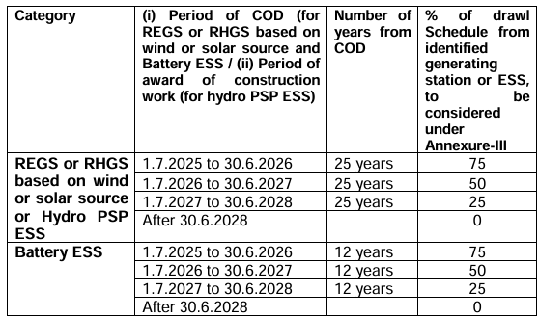
4. Amendment to Regulation 13 of the Principal Regulations –Cont.

Slide 4
4. Amendment to Regulation 13 of the Principal Regulations –Cont.
Views of GRIDCO:
It is suggested that the period for award of construction work for Hydro PSP ESS for availing 100 % waiver of ISTS charges may be extended by another 3 years till 30.06.2028 to enable States like Odisha to maximise their potential from such sources.
Justification :
Odisha’s PSP policy is in final stages for approval.
Large number of clearances.
Large potential for PSPs and till date MoU of around 3 GW has been executed with the Central PSUs. Award of contracts will take much longer due to the associated activities related with awarding contracts of PSPs.
Tariff for PSP remains higher which needs to be rationalized in consumer interest.

Slide 5
4. Amendment to Regulation 13 of the Principal Regulations –Cont.
(7) A new sub-clause (h) shall be inserted after sub-clause (g) under Clause (2) of Regulation 13 of the Principal Regulations as under:
(h) Any REGS based on wind or solar source which is eligible for a waiver of inter-state transmission charges under Regulation 13(2) of these regulations and is having its scheduled date of commissioning on or before 30th June 2025 is granted extension of time to achieve COD by the competent authority in terms of the Power Purchase Agreements (where PPA has been entered into with, a Renewable Energy Implementing Agency or a distribution licensee or an authorized agency on behalf of distribution licensee, consequent to tariff based competitive bidding) or the Commission (for cases other than specified PPA, on an appropriate application made by the entity), on account of any Force Majeure event including non-availability of transmission or for reasons not attributable to the REGS, and the project achieves COD before the extended date, it shall be eligible for a waiver of inter-state transmission charges as if the said REGS had achieved COD on 30.6.2025:
Provided that, for the purpose of this Clause, such extension shall not exceed a period of six months at a time and not more than two times.”

Slide 6
4. Amendment to Regulation 13 of the Principal Regulations –Cont.
Views:
Hon’ble Commission may grant further time beyond the permissible time of one year on a case-to-case basis with due diligence.
Justification :
GRIDCO has executed 03 Power Sale Agreements with SECI to procure 1000 MW Wind Power towards Compliance of RPO
Delay in Tariff Adoption and approval of the PSA in other SERC’s, the SCOD of the Projects has been revised by SECI to beyond 30.06.2025
The WPDs are anticipating further delay in projects
It is anticipated that some of the projects under the above Schemes may not come even before 30.06.2026.
Burden of applicable ISTS charges may be borne by entities responsible for delay.

Slide 7
        THANK YOU

